Slide 1
ARIES: CLOSED LOOP Irrigation

Slide 2
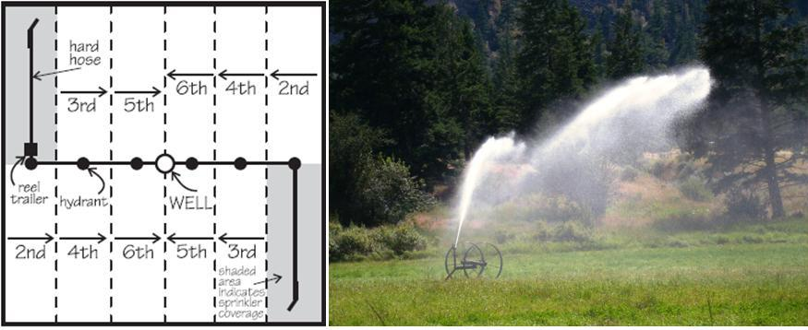
Irrigation
Artificial application of water to the land to increase crop yield.
Necessary in arid areas or during a period of inadequate rainfall.
Several methods exist such as:
Surface Irrigation
Manual Irrigation
Automatic Irrigation
Sprinkler Irrigation
Drip Irrigation
Subsurface Drip Irrigation
Spate Irrigation
Sprinkler irrigation (“big gun”) in South Canada.

Slide 3
AUTOMATIC IRRIGATION

Slide 4
Basic Irrigation Principles
High labour input and high self-help compatibility
Require no technical equipment, therefore they are cheap
Beside water cans, there more “automated” methods such as:
Low-Cost Drip Irrigation System
Pitcher Irrigation
Bottle Irrigation
Porous and Sectioned Pipes
Perforated Plastic Sleeves

Slide 5
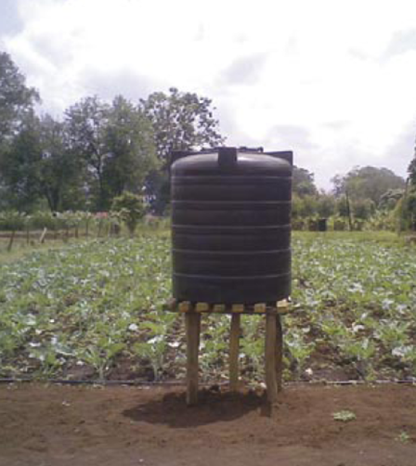
Low-Cost Drip Irrigation System
Low-cost plastic pipes laid on the ground and irrigate crops.
Small holes in the pipes allow a water to drip out.
A water tank on a higher level distributes water by gravity.
No waste of water (e.g. evaporation, wind), specific irrigation at the root zone.
A low-cost “farm-kit system” with a 1000 litres water tank can service up one-eight of an acre.

Slide 6
Applicability
The system depends on three factors: type of soil, water quality and climate, plant and labours.
Permeable soil: difficult to transport the water over the whole field.
It can be implemented in windy regions in contrast to sprinkler systems.
It is not highly automated, but labour intensive.

Slide 7
SPRINKLER IRRIGATION

Slide 8
Design Principles
Widely used and well-known.
Water is distributed through a system of pipes (usually by pumping) and spray heads at the outlets distribute the water over the entire soil surface.
This system, especially large ones, are mostly automated.
It can be found in small vegetable gardens up to large crop fields. Therefore several systems were developed:
Sprinkler heads
Centre Pivot
Linear Move
Travelling Big Gun
Side Roll

Slide 9
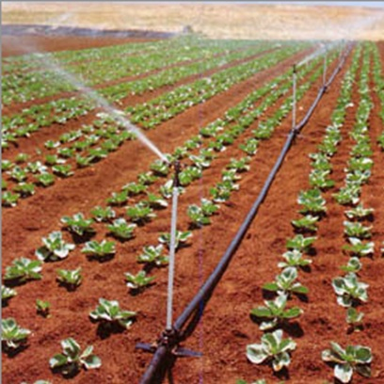
Sprinkler Head
Two types: Impact and gear-drive sprinklers.
Spray nozzles discharge water and covers typically an area up to 12 m (head-to-head).
Single sprinklers can be connected to each other with laterals
Lager system are mostly automated (e.g. time based)
Used in gardens, pastures and larger lawn areas.
A vegetable field irrigated by interconnected sprinkler heads.

Slide 10
Applicability
Best suited for sandy soils with high infiltration rates, but in general suited for most soil types.
Average application rate must lower than the infiltration rate to avoid ponding.
Not suitable for soils that easily form a crust or in case of risk of salinisation.
Sprinklers that produce a light fine spray should be preferred to avoid damages on crop/soil.

Slide 11
COMMERCIAL,SMALL-SCALE AND SELF MADE IRRIGATION SYSTEM

Slide 12
Design Principles
Water is conveyed under pressure through a pipe system to the fields.
It drips slowly onto the soil through emitters or drippers which are located close to the plants.
Only the root zone is wetted.
There are very technical systems but also self-made designs.
It requires relatively small amounts of water, but it is very effective.
Pre-treated waste water or urine can be added as a fertiliser.

Slide 13
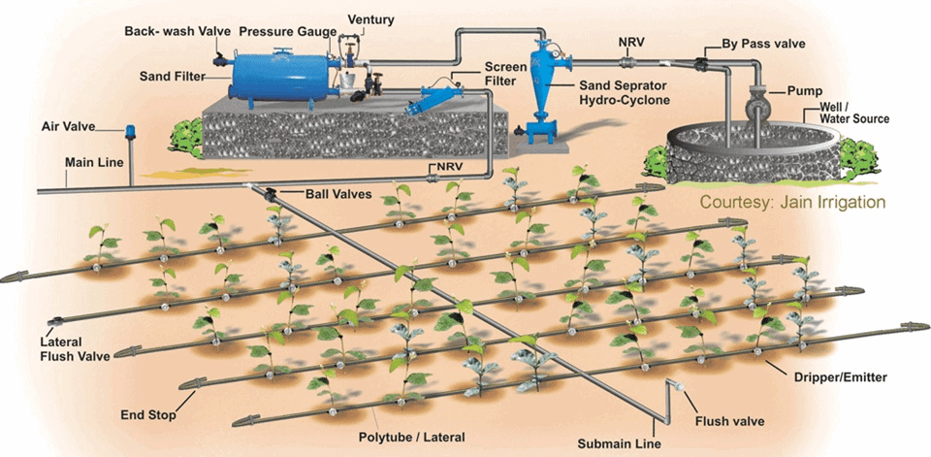
Commercial Drip Irrigation System
Schematic design of a commercial drip irrigation system. This includes technical components such as filters, pumps and hydraulic control valves.

Slide 14
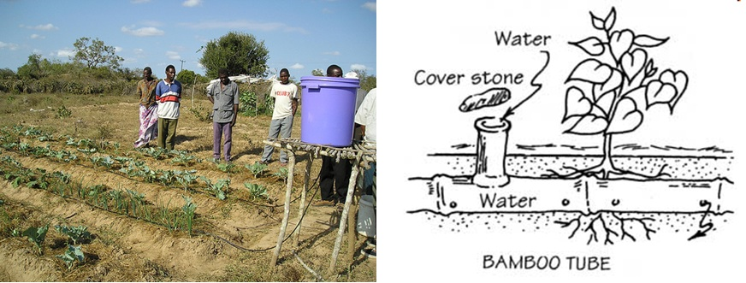
Small Scale and Self-Made Drip Irrigation Systems
Small initial investment, especially for small scale famers.
Can be built with local available material.
High self-help compatibility (farmers might need training at the beginning).
Wastewater should be pre-treated and filtered to avoid infections and clogging.
A self-made irrigation system in Africa with a bucket as a water reservoir and simple plastic hoses for the distribution. If bamboo is available, it can be used as distribution pipes.

Slide 15
HIGH TECH AND LOW TECH SOLUTIONS

Slide 16
Basic Design Principles
Once it is installed, the irrigation system has not to be controlled all the time.
Modern big scale systems operated by one (skilled) labour.
Very technical components required. There even high-tech solutions using GIS and satellites to measure water needs.
Time Based System
Volume Based System
Open Loop Systems
Closed Loop Systems
Real Time Feedback System
Computer Based Irrigation Control Systems
There also simple methods such as clay pot irrigation networks.

Slide 17
High-Tech Solutions
Time Based
Time of operation (irrigation time – hrs per day) is calculated according to volume of water (water requirement - litres per day) required and the average flow rate of water (application rate – litres per hours). A timer starts and stops irrigation.
Volume Based
The pre-set amount of water can be applied in the field segments by using automatic volume controlled metering valves.
Open Loop System
Open loop controllers normally come with a clock that is used to start irrigation.
Termination of the irrigation can be based on a pre-set time or may be based on a specified volume of water passing through a flow meter.

Slide 18
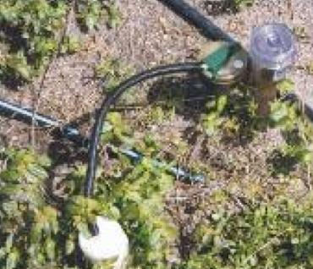
High-Tech Solutions
Closed Loop Systems
This type of system, the feedback and control of the system are done continuously.
Closed loop controllers require data acquisition of environmental parameters (such as soil moisture, temperature, radiation, wind-speed, etc) as well as system parameters (pressure, flow, etc.).
Simple version of a closed loop system: A moisture sensor interrupts/starts the irrigation process.
Real Time Feedback System
Various sensors, tensiometers, relative humidity sensors, rain sensors, temperature sensors etc. control the irrigation scheduling. These sensors provide feedback to the controller to control its operation

Slide 19
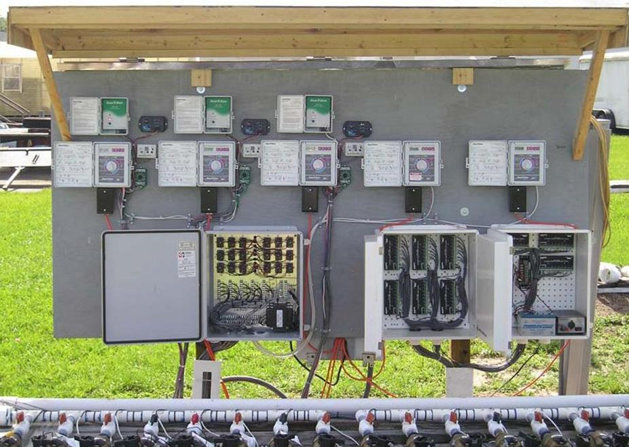
High-Tech Solutions
Computer-based Irrigation Control Systems (This system consists of a combination of hardware and software that acts as a supervisor with the purpose of managing irrigation and other related practices such as [1995-fertigation] and maintenance.
Basically two systems: Interactive and fully automatic systems.
Control board showing timers, soil moisture sensor-controllers, solenoid valves wiring.

Slide 20
DESIGNING PRINCIPLE OF CLOSED LOOP IRRIGATION SYSTEM

Slide 21
DHT11 Humidity &
Temperature Sensor
DHT11 Temperature & Humidity Sensor features a
temperature & humidity sensor complex with a
calibrated digital signal output.

Slide 22
DHT 11 Humidity & Temperature
Sensor
1. Introduction
DHT11 Temperature & Humidity Sensor features a temperature & humidity sensor
complex with a calibrated digital signal output. By using the exclusive digital-signal-acquisition
technique and temperature & humidity sensing technology, it ensures high reliability and
excellent long-term stability. This sensor includes a resistive-type humidity measurement
component and an NTC temperature measurement component, and connects to a highperformance
8-bit microcontroller, offering excellent quality, fast response, anti-interference
ability and cost-effectiveness.

Slide 23
Each DHT11 element is strictly calibrated in the laboratory that is extremely accurate on
humidity calibration. The calibration coefficients are stored as programmes in the OTP memory,
which are used by the sensor’s internal signal detecting process. The single-wire serial interface
makes system integration quick and easy. Its small size, low power consumption and up-to-20
meter signal transmission making it the best choice for various applications, including those
most demanding ones. The component is 4-pin single row pin package. It is convenient to
connect and special packages can be provided according to users’ request.
2. Technical Specifications:
Overview:
Item | Measurement | Humidity accuracy | Temperature accuracy | Resolution | package
DHT11 | 20-90%RH 0-50 ℃ | ±5% RH | ±2℃ | 1 | 4 PIN SINGLE ROW

Slide 24
Electrical Characteristics
VDD=5V, T = 25℃ (unless otherwise stated)
 | Conditions | Minimum | Typical | Maximum
Power Supply | DC | 3V | 5V | 5.5V
Current Supply | Measuring | 0.5mA | - | 2.5mA
Sampling period | Second | 1

Slide 25
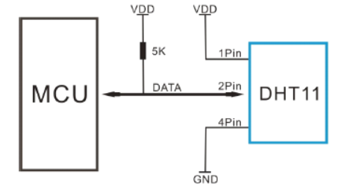
CIRCUIT DIAGRAMS
ARDUINO UNO

Slide 26
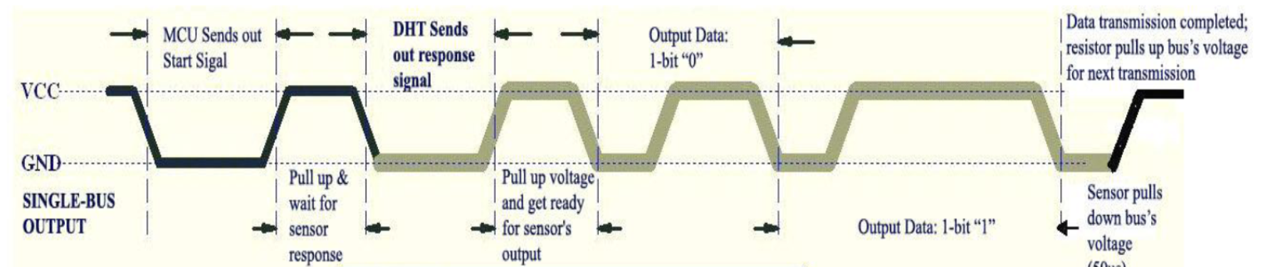
Overall Communication Process
When MCU sends a start signal, DHT11 changes from the low-power-consumption mode to the
running-mode, waiting for MCU completing the start signal. Once it is completed, DHT11 sends a
response signal of 40-bit data that include the relative humidity and temperature information to
MCU. Users can choose to collect (read) some data. Without the start signal from MCU, DHT11
will not give the response signal to MCU. Once data is collected, DHT11 will change to the lowpower-
consumption mode until it receives a start signal from MCU again.

Slide 27
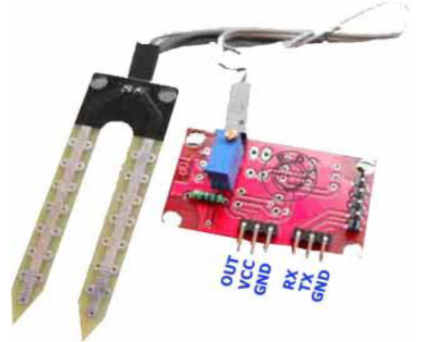
Soil Moisture Sensor :
This sensor can be used to test the moisture of soil, when the soil is having water shortage, the module output is at high level, else the output is at low level. By using this sensor one can automatically water the flower plant, or any other plants requiring automatic watering technique. Module triple output mode, digital output is simple, analog output more accurate, serial output with exact readings.

Slide 28
Working :
Soil moisture sensors measure the water content in soil. A soil moisture probe is made up of multiple soil moisture sensors.
Soil moisture content may be determined via its effect on dielectric constant by measuring the capacitance between two electrodes implanted in the soil. Where soil moisture is predominantly in the form of free water (e.g., in sandy soils),
The dielectric constant is directly proportional to the moisture content. The readout from the probe is not linear with water content and is influenced by soil type and soil temperature. Therefore, careful calibration is required and long-term stability of the calibration is questionable.
• In This sensor We are using 2 Probes to be dipped into the Soil
• As per Moisture We will get Analoug Output variations from 0.60volts - 5volts
• Input Voltage 5V DC

Slide 29
Applicability Of Project
The system depends on three factors: type of soil ,crop , climate and temperature
It can be implemented in windy regions in sprinkler and drip irrigation systems which avoids the water loss.
It is automated, but proper maintenance requires.
It can be available at low cost so the farmers can afford it.

Slide 30
BLOCK DIAGRAM OF PROJECT

Slide 31
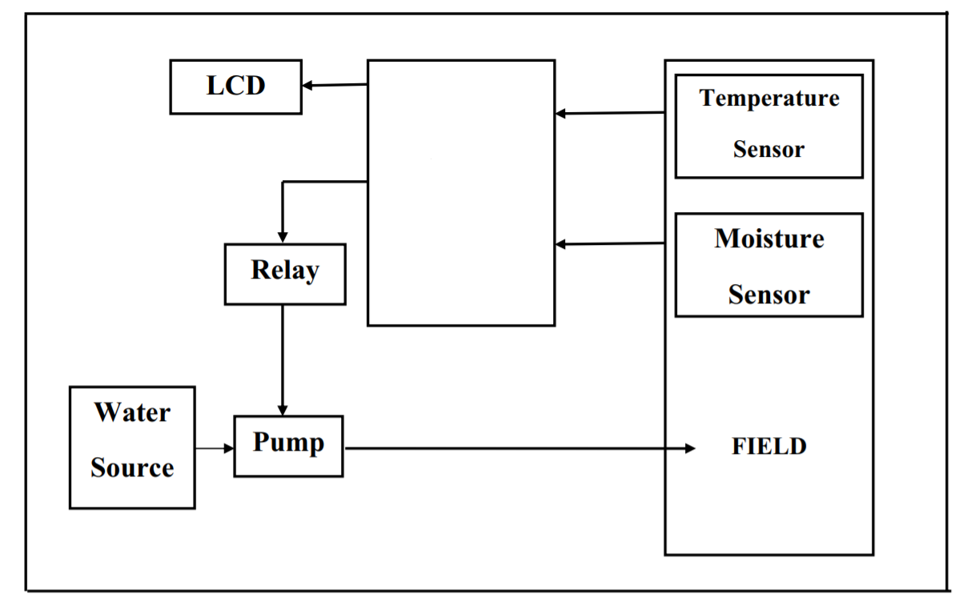
UI
M MCU
MCU
ATMEGA328P-P
ATMEGA328P-PU

Slide 32
THREE PHASES FOR A EFFECTIVE PRODUCT
INNOVATION
IMPLEMENTATION
COMMERCIALISATION

Slide 33
PROBLEMS WE FACE AFTER COMPLETING PROJECT
1.Illiteray in farmers
2.Money problems
3.Connectivity problems regarding language, internet connection
4.Project installation problems including training and setup of sensors
5.Maintanence problems regarding destruction of sensors

Slide 34
Solutions of the problems

Slide 35
Problem: illiteracy
1.Advertisement of the project in their regional language
2.Awareness programs relating their problems in irrigation
3.Mentors are available for guiding to village sarpanch on which the farmers trust

Slide 36
PROBLEM:COST
1.Government support to farmers
2.Low-Maintainence Cost
3.Free installation
4.Every month replacement of the sensors is done and half cost is refunded.

Slide 37
PROBLEM : CONNECTIVITY
Internet problem
Aware them about the projects like bharatnet which facilities internet in every village
If they don’t have mobile phones we can connect them through the radio signals.
conducting surveys periodically
Language barrier
1.The message about sensors connectivity is shown on their mobile phones.
2.If they don’t have mobile phones , we will take help of radio to find their regional language and the radio telecast is in their own regional language can be conducted and have an radio announcement at regular interval of time .

Slide 38
PROBLEMS:INSTALLATION PROBLEM
1.Providing basic installation training to them
2.Regional pictured language manual provided with the product
3.Installation of sensors be at minimum places like at corners
of irrigation field so they are not destroyed during
harvesting of crops

Slide 39
Maintenance

Slide 40
PROBLEM: MAINTAINENCE
Fastest maintainence service provided
New sensors are replaced at min cost in alternative to destroyed ones
Conducting surveys

Slide 41
THANK - YOU

